Slide 1
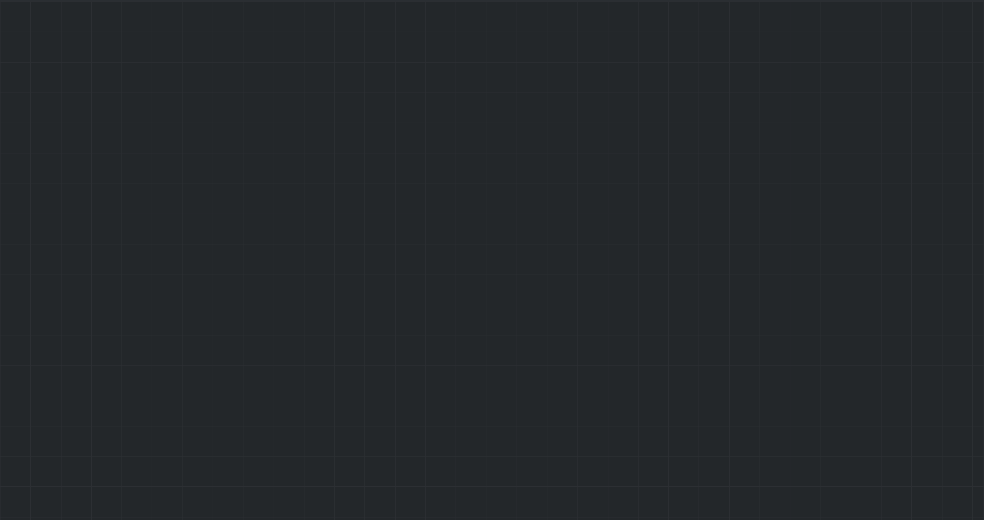
Multiplier Snake Game
By: Karan Munday

Slide 2
Introduction
PvP snakes
5 “fruits” on the map
Designed for 2 person PvP but can handle more
Multiple games can be running at any given time

Slide 3
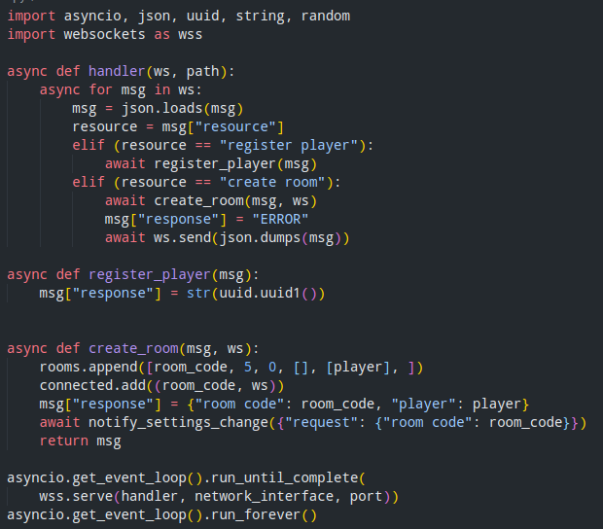
Server Implementation
Uses web sockets and json
Very little data processing
Asynchronies data handling
Multiple concurrent games

Slide 4
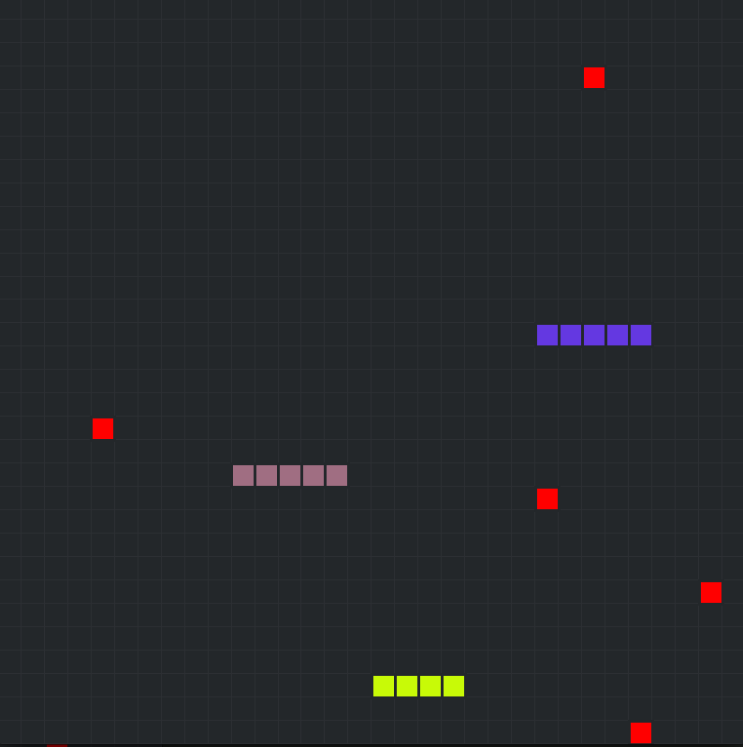
Client Implementation
Multi-Threaded
Constantly listening for changes
Constantly drawing the game
Asynchronies data handling
Join and Create a lobby
Customize your snake

Slide 5
Demo

